Slide 1

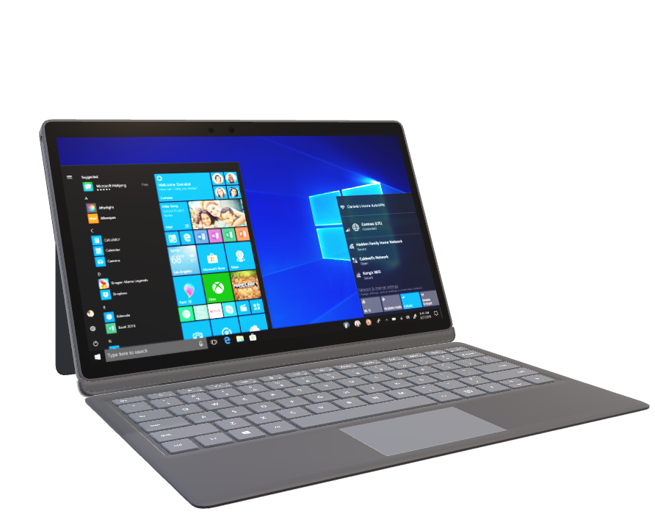
t
Unit IV : ICT In Assessment
Name: Rasana Ghimire
Roll no: 7621025
Sanothimi campus

Slide 2

t
Agenda
What is ICT?
What is assessment in e- learning?
ICT in assessment
Types of assessment
Current trends in assessment

Slide 3
t
ICT (Information & Communication Technology)
ICT is a set of technological tools and resources used to transmit, store, create ,share or exchange information.
ICT offers a variety of application in education that helps students to develop the skills and competencies.
Tools like: Ms powerpoint, googlclassroom, projector,scanner,
spreadsheet etc.

Slide 4
t
What is assessment in e- learning?
Assessment refers to evaluating learners progress and knowledge within an online environment.
It is the process of identifying, gathering, and interpreting information about students learning.
It provides insight into the quality and effectiveness of training and can take many forms, such as test, quiz, assignment, presentation, project etc.

Slide 5
t
ICT In Assessment
It is the backbone for teaching and learning.
Children confidence is increased by technology enabled evaluation since they receive rapid feedback on their learning.
Assessment basically helps to improve learning and also set direction for ongoing teaching and learning process.
Assessment involves using wide variety of method and tools to evaluate, measure and document the student learning.

Slide 6

t
Types of assessment
Formative assessment
Summative assessment
Diagnostic assessment
Authentic assessment
Performance assessment

Slide 7
t
Formative Assessment
It refers to frequent, interactive assessment of student progress and understanding to identify learning needs and adjust teaching appropriately.
Formative assessment provides feedback and information during the instructional process while learning is taking place, and while learning is occuring.
Advantages
Continuity
Provides continuous feedback
Habbit to interact each other
Findout weakness & strength point of student
Good relationship between teacher and student

Slide 8
t
Summative assessment
It is the process to evaluate student learning at the end of an instruction unit by comparing it against some standard or benchmark.
It takes place after the learning has been completed and provides information and feedback that sums up the teaching and learning process.
Examples: Mid term exam, final exam, final project, final essay
Advantages
Freedom from active participation in discussion
Summative assessment reinforce the overall learning objective of the course.

Slide 9
t
Diagnostic Assessment
It is closely related to formative assessment.
It helps us to identify students current knowledge of a student.
Knowing student’s strength & weakness can help to do better plan what to teach and how to teach it.
It clarify misconceptions before teaching and sets the skills and capabilities.
This information should be shared with student to plan the next steps to improve their learning.

Slide 10
t
Authentic Assessment
The idea of using creative learning experience to test students skills and knowledge in realistic situations.
Authentic assessment provides student with a variety of ways to demonstrate their skills and knowledge.
It emphasis what student know, rather than what they do not or requires student to develop response instead of selecting them from predetermined options.

Slide 11
t
Performance Assessment
Performance assessment is one which requires student to demonstrate that they have mastered specific skills and competencies by performing or producing something.
Importances
Provides real time feedback
Increases engagement
Final thought
Can make customized learning paths
Encourage collaborative learning

Slide 12
t
Current Trends In Assessment
Classroom assessment
Formative assessment
For provide feedback
Policy maker National curriculum framework 2063
2. Tests
Summative assessment
Policy maker ministry of education
For valuable information about a students overall performance at a specific point in their learning.
3. Large scale or systematic assessment
For specific purpose
Multiple choose, short answer question, sample based
Policy maker service commision

Slide 13
Thank You!

Slide 14
t
4.3 Role of ICT in Assessment 4.3.1 Computer Assisted Assessment (CAA) 4.3.2 Computer Adaptive Testing
Presented by Sangita Rai

Slide 15
t
Agenda
Role of ICT in Assessment
ICT Assessment Tool
3. Computer Assisted Assessment (CAA)
4. Why Use Computer Assisted Assessment
Computer Adaptive Testing
Advantages of CAT
Disadvantages of CAT

Slide 16
t
Role of ICT in Assessment
Score tests
Analyze results
Give grades or feedback to students
Facilitate teachers in assessing learning outcomes
Integrate in completing student’s task such as portfolio and project-based assessment
Store and record information about how students are developing understanding of new material
Take over some of the role of assessing and providing feedback to students so that teachers can focus on other aspects of supporting learning
Increase children's confidence by technology-enabled evaluation since they receive rapid feedback on their learning
Set up evaluation so that children receive quick feedback and can therefore repair their mistakes and go forward

Slide 17
t
ICT Assessment Tool
Kalzium
Google Earth
QGIS
KmPlot
ANATOMY 3D
Socrative

Slide 18
t
Computer Assisted Assessment (CAA)
Computer Assisted Assessment (CAA) is a process that involves the use of computer-based tools and technologies to evaluate and assess the knowledge, skills, and performance of learners.
Stages of Assessment | CAA examples
Supporting students with the assessment | Facilitate a discussion with students on assessments and criteria Provide past exam papers to students or other assessment information
Assessment event | Assess an online collaborative activity Assess students' development over time
Marking & feedback production | Students submit assessments electronically
Record-keeping | Store and retrieve marks electronically
Feedback to students | Facilitate peer and/or tutor feedback

Slide 19
t
Why Use Computer Assisted Assessment
Motivating and encouraging students to practice skills by providing opportunities for formative assessment
Broadening the range of knowledge assessed (e.g. creating websites or complex diagrams) and extending the range of assessment methods (e.g. peer assessment, self-assessment)
Offering opportunities for more immediate feedback, as well as allowing feedback to be delivered in different ways

Slide 20
t
Computer Adaptive Testing
Computer Adaptive Testing (CAT) is an assessment method that uses computer technology to deliver and adapt test questions or items to the individual abilities and characteristics of the test taker. Unlike traditional paper-based or computer-based tests, which present a fixed set of questions to all test takers, CAT dynamically adjusts the difficulty level of questions based on the test taker's responses during the examination.
Computer Adaptive Testing (CAT) is a method of assessment that adapts the difficulty level of test questions based on the test taker's performance.
In CAT, the initial test question presented to the test taker is of moderate difficulty, and subsequent questions are selected based on the correctness of previous responses.
The selection of questions in CAT is determined by sophisticated algorithms that aim to measure the test taker's ability accurately and efficiently.
CAT provides a personalized testing experience by adjusting the difficulty level of questions in real-time.

Slide 21
t
Advantages of CAT
Personalized assessments based on individual abilities for accurate results.
Efficient testing saves time and reduces test fatigue.
Real-time feedback for instant scoring and performance evaluation.
Dynamic question selection ensures comprehensive assessment of knowledge and skills.
Reduced test bias with appropriate questions for fair evaluation.
Improved test security with random question selection.

Slide 22
t
Disadvantages of CAT
The first issue encountered in CAT is the calibration of the item pool.
Although adaptive tests have exposure control algorithms to prevent overuse of a few items, the
exposure conditioned upon ability is often not controlled.
In a CAT with a time limit it is impossible for the examinee to accurately budget the time one can spend
on each test item and to determine if he/she is on pace to complete a timed test section.

Slide 23

Any Question?

Slide 24
Thank You!

Slide 25
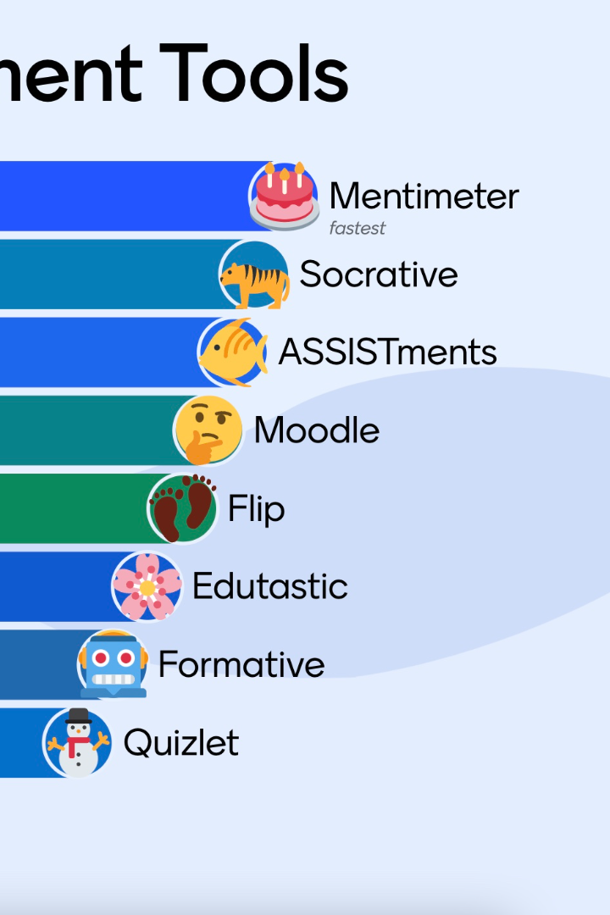
Assessment: Digital Tools and Options
Welcome to our presentation on the current state of digital assessment tools. Here we will explore the various types of tools, their benefits, challenges, and much more!
Dk
Presenter by : Dhiraj Kumar Shah
Symbol no: 7621009

Slide 26

t
Agenda
4.4 Assessment: Digital Tools and Options
4.5 E-portfolio
4.5.1 Tools for Creating e-portfolio
4.5.2 Advantages of e-portfolio

Slide 27
Assessment: Digital Tools and Options
There are a large number of ICT tools.
The services supporting various kinds of assessment activities.
Some of these are offered as specific modules of learning management systems (LMS) like Moodle that enable the management of question banks and items together with the administration and internet-based delivery of tests.
The various assessment question types which are available in LMS like Moodle are calculated, description, essay, matching, embedded answers, multiple choice, short answer, numerical, true/false, drag and drop, jigsaw, ordering, multi select, short answer etc.

Slide 28
The Different Types of Digital Assessment
Formative Assessment
Summative Assessment
Diagnostic Assessment
Checking how students are learning during instruction
Evaluating students' learning at the end of instruction
Assessing students' knowledge and skills before instruction
Authentic Assessment
Using real-world situations to assess students' knowledge and skills

Slide 29
The Benefits of Digital Assessment
1
Improved Feedback
Digital assessments allow for immediate and specific feedback, helping students improve quickly.
Increased Efficiency
2
Digital assessments reduce grading time and errors, providing more time for instruction.
3
Personalization
With digital assessments, teachers can easily differentiate instruction to meet the individual needs of their students.

Slide 30


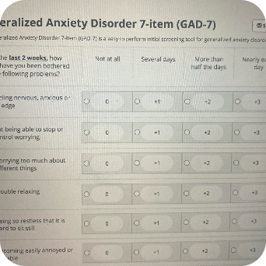

The Challenges with Digital Assessment
Technical Issues
Cheating Prevention
Assessment Anxiety
Data Security
System crashes and connectivity problems can be frustrating for both students and teachers.
Preventing cheating can be more challenging with digital assessments due to the ease of sharing information.
Some students may suffer from assessment anxiety when taking digital assessments due to unfamiliarity with the tools.
Data security is always a concern when using digital assessment tools.

Slide 31
Real-World Examples of Digital Assessment
Tool
Application
Benefits
Customizable assessments and immediate feedback
Edulastic
Formative and summative assessment
Quick formative assessment and data collection
Socrative
Online quizzes and exit tickets
Classcraft
Game-based formative assessment
Improved student engagement and motivation
Clever
Automatic roster syncing and application integration
Streamlined administration and increase in productivity

Slide 32
Considerations When Selecting Digital Assessment Tools
Reliability
Choose a tool that has been tested and reviewed, and ensure it is compatible with your other systems.
1
2
3
Accessibility
Cost
Ensure all students have equal access to the tools and understand how to use them.
Consider the initial cost as well as any subscription fees, and make sure it fits within your budget.

Slide 33

Best Practices for Implementing Digital Assessment
1
Provide Adequate Preparation
2
Maintain Equitable Practices
3
Use Varied Assessment Types
Train students on how to use the tools and provide enough practice beforehand.
Ensure all students are assessed fairly, and prevent cheating through strict monitoring.
Use a variety of assessment types to cater to students’ individual needs and learning styles.

Slide 34
The Future of Digital Assessment
Adaptive Assessments
Integration with AI
Real-Time Assessment Data
Assessments that adjust to each student's knowledge, providing personalized feedback and resources.
AI could be used to grade open-ended responses and provide more accurate feedback.
Tools that provide real-time data analysis, allowing immediate feedback and identification of areas that need improvement.

Slide 35

Tools for Creating e-portfolio for Student
When it comes to creating an e-portfolio, students have plenty of tools to choose from. Let's take a closer look at the benefits of e-portfolios, types of tools available, and how to choose the right one for your needs.

Slide 36
The Benefits of E-portfolios for Students
Reflective Learning
E-portfolios encourage reflection on your learning and development, helping to identify areas for improvement and growth.
1
2
3
Visual Showcase
Access Anywhere
A great way to showcase your work visually, allowing you to go beyond traditional resumes and cover letters.
E-portfolios are digital, making them easy to access anytime, anywhere, and from any device.

Slide 37




Types of E-portfolio Tools
Google Sites
WordPress
Weebly
Wix
A free and user-friendly tool, ideal for beginners and those with limited web design experiences.
WordPress is an open-source platform that offers a high level of customization and scalability. It has numerous templates and themes, optimized for all types of businesses.
Weebly is another online platform that allows a simplistic drag-and-drop functionality to create a website without spending time on the underlying technicalities.
Wix is a simple and user-friendly platform for creating visually appealing and responsive e-portfolios. It has various templates for different categories and requirements.

Slide 38
Tools for Creating E-portfolio
easy portfolios
Evernote
voice thread
open school e-portfolio
three ring
kidblog
wikispaces for education
weebly
Edusight
Evernote Scannable
Notability
Google Drive
Mahara.org

Slide 39
Comparison of Popular E-portfolio Tools
Customization
Popularity
WordPress and Wix are highly customizable, while Google Sites and Weebly have a limited range of design options.
WordPress and Wix are two of the most widely used e-portfolio tools on the market.
1
2
3
4
Price
Mobile Friendly
Google Sites and Weebly are free, while WordPress and Wix have both free and paid options.
Wix, WordPress, and Weebly all offer mobile-optimized websites or apps, while Google Site’s mobile compatibility is limited.

Slide 40
Key Features to Look for in E-portfolio Tools
Flexibility
User-Friendly Interface
Robust Security
The tool should be flexible and versatile, providing scope for creativity and personalization.
The platform should be easy to use, with a straightforward user interface and drag-and-drop functionality.
The tool should be secure, with features such as identity verification, access control, and backups to protect your work.
Integration with other tools
The tool should integrate well with other tools such as social media platforms and applications like DropBox, Google Drive, etc.

Slide 41
t
Advantages of E-portfolio
A well-executed e-portfolio program is a very good tool for higher education.
It builds learners personal and academic growth as they complete complex activities.
It facilitates the integration of learning as students connect learning across courses.
It helps students plan their own academic pathways as they understand what they know and are able to do and what they still need to learn.

Slide 42

Conclusion
Creating an e-portfolio can be the first step towards an outstanding career. It is a powerful instrument that can help students in demonstrating their achievements, skills, and development, both to themselves and to potential employers.

Slide 43


t
Thanks!
Do you have any questions? dtisp2020@gmail.com
Personal details

